Slide 1

SpaceX
Mission to Mars - Making Life Multi-Planetary Species

Slide 2
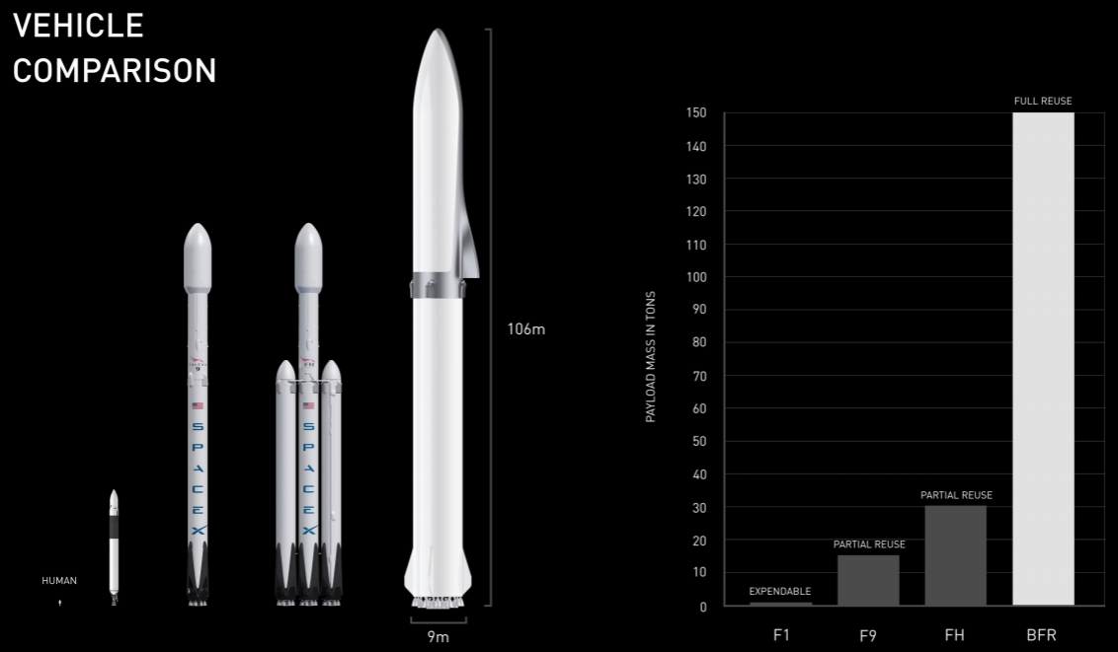

Slide 3
Milestones
First privately funded liquid-propellant rocket to reach orbit (Falcon 1 in 2008)
First privately funded company to successfully launch, orbit, and recover a spacecraft (Dragon in 2010)
First private company to send a spacecraft to the International Space Station (Dragon in 2012)
First propulsive landing for an orbital rocket (Falcon 9 in 2015)
First reuse of an orbital rocket (Falcon 9 in 2017)
First privately funded space agency to launch an object into solar orbit (Falcon Heavy's payload of a Tesla Roadster in 2018)

Slide 4
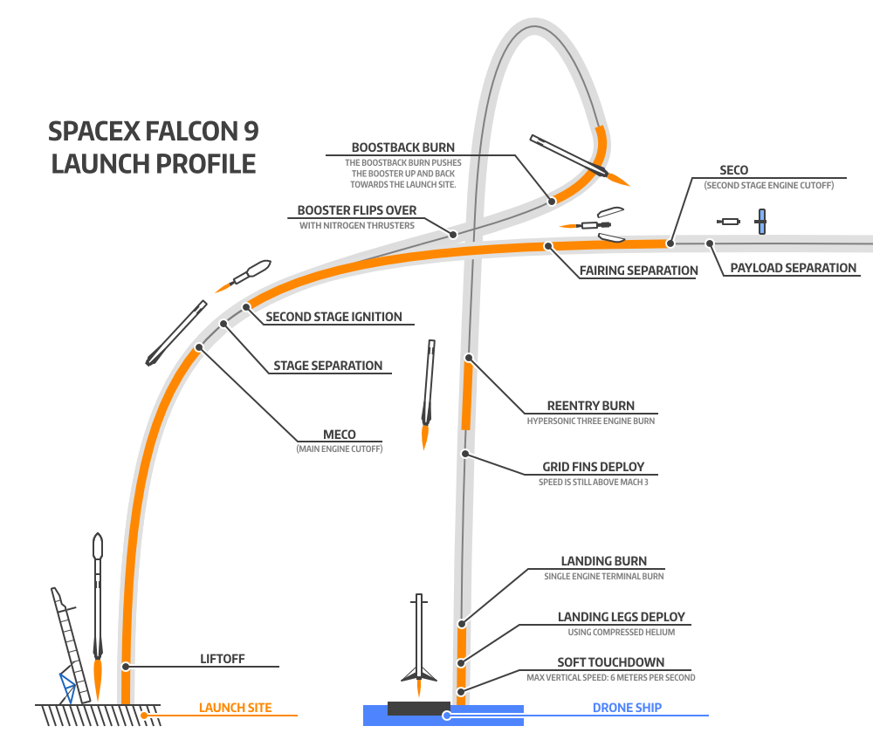

Slide 5
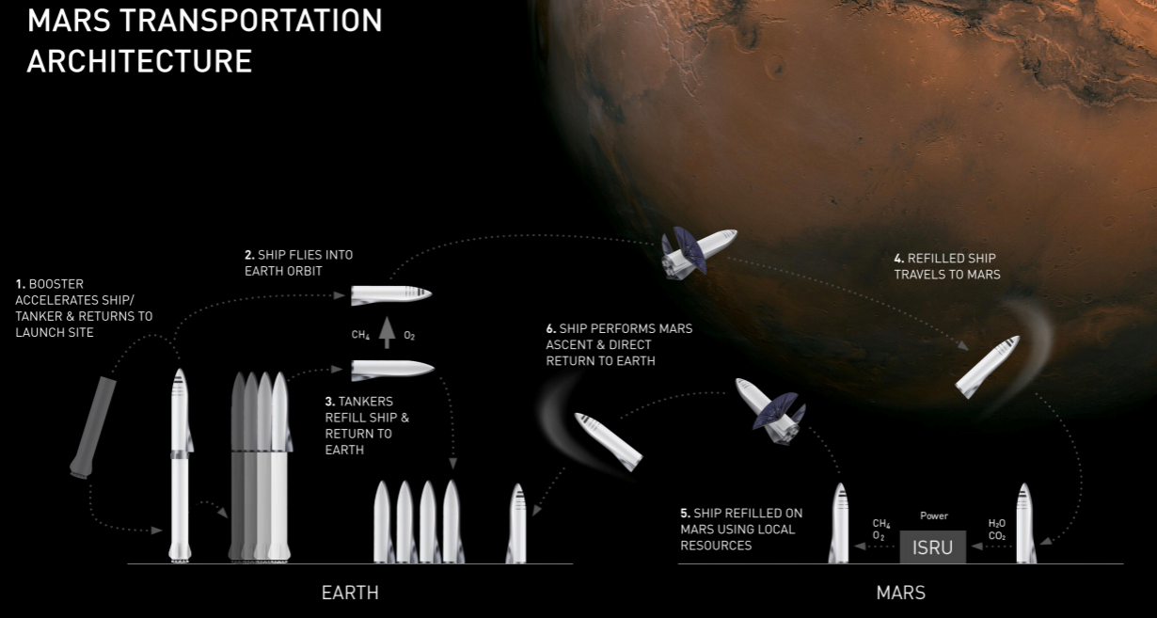

Slide 6
